Slide 1
Anime character detection

Slide 2

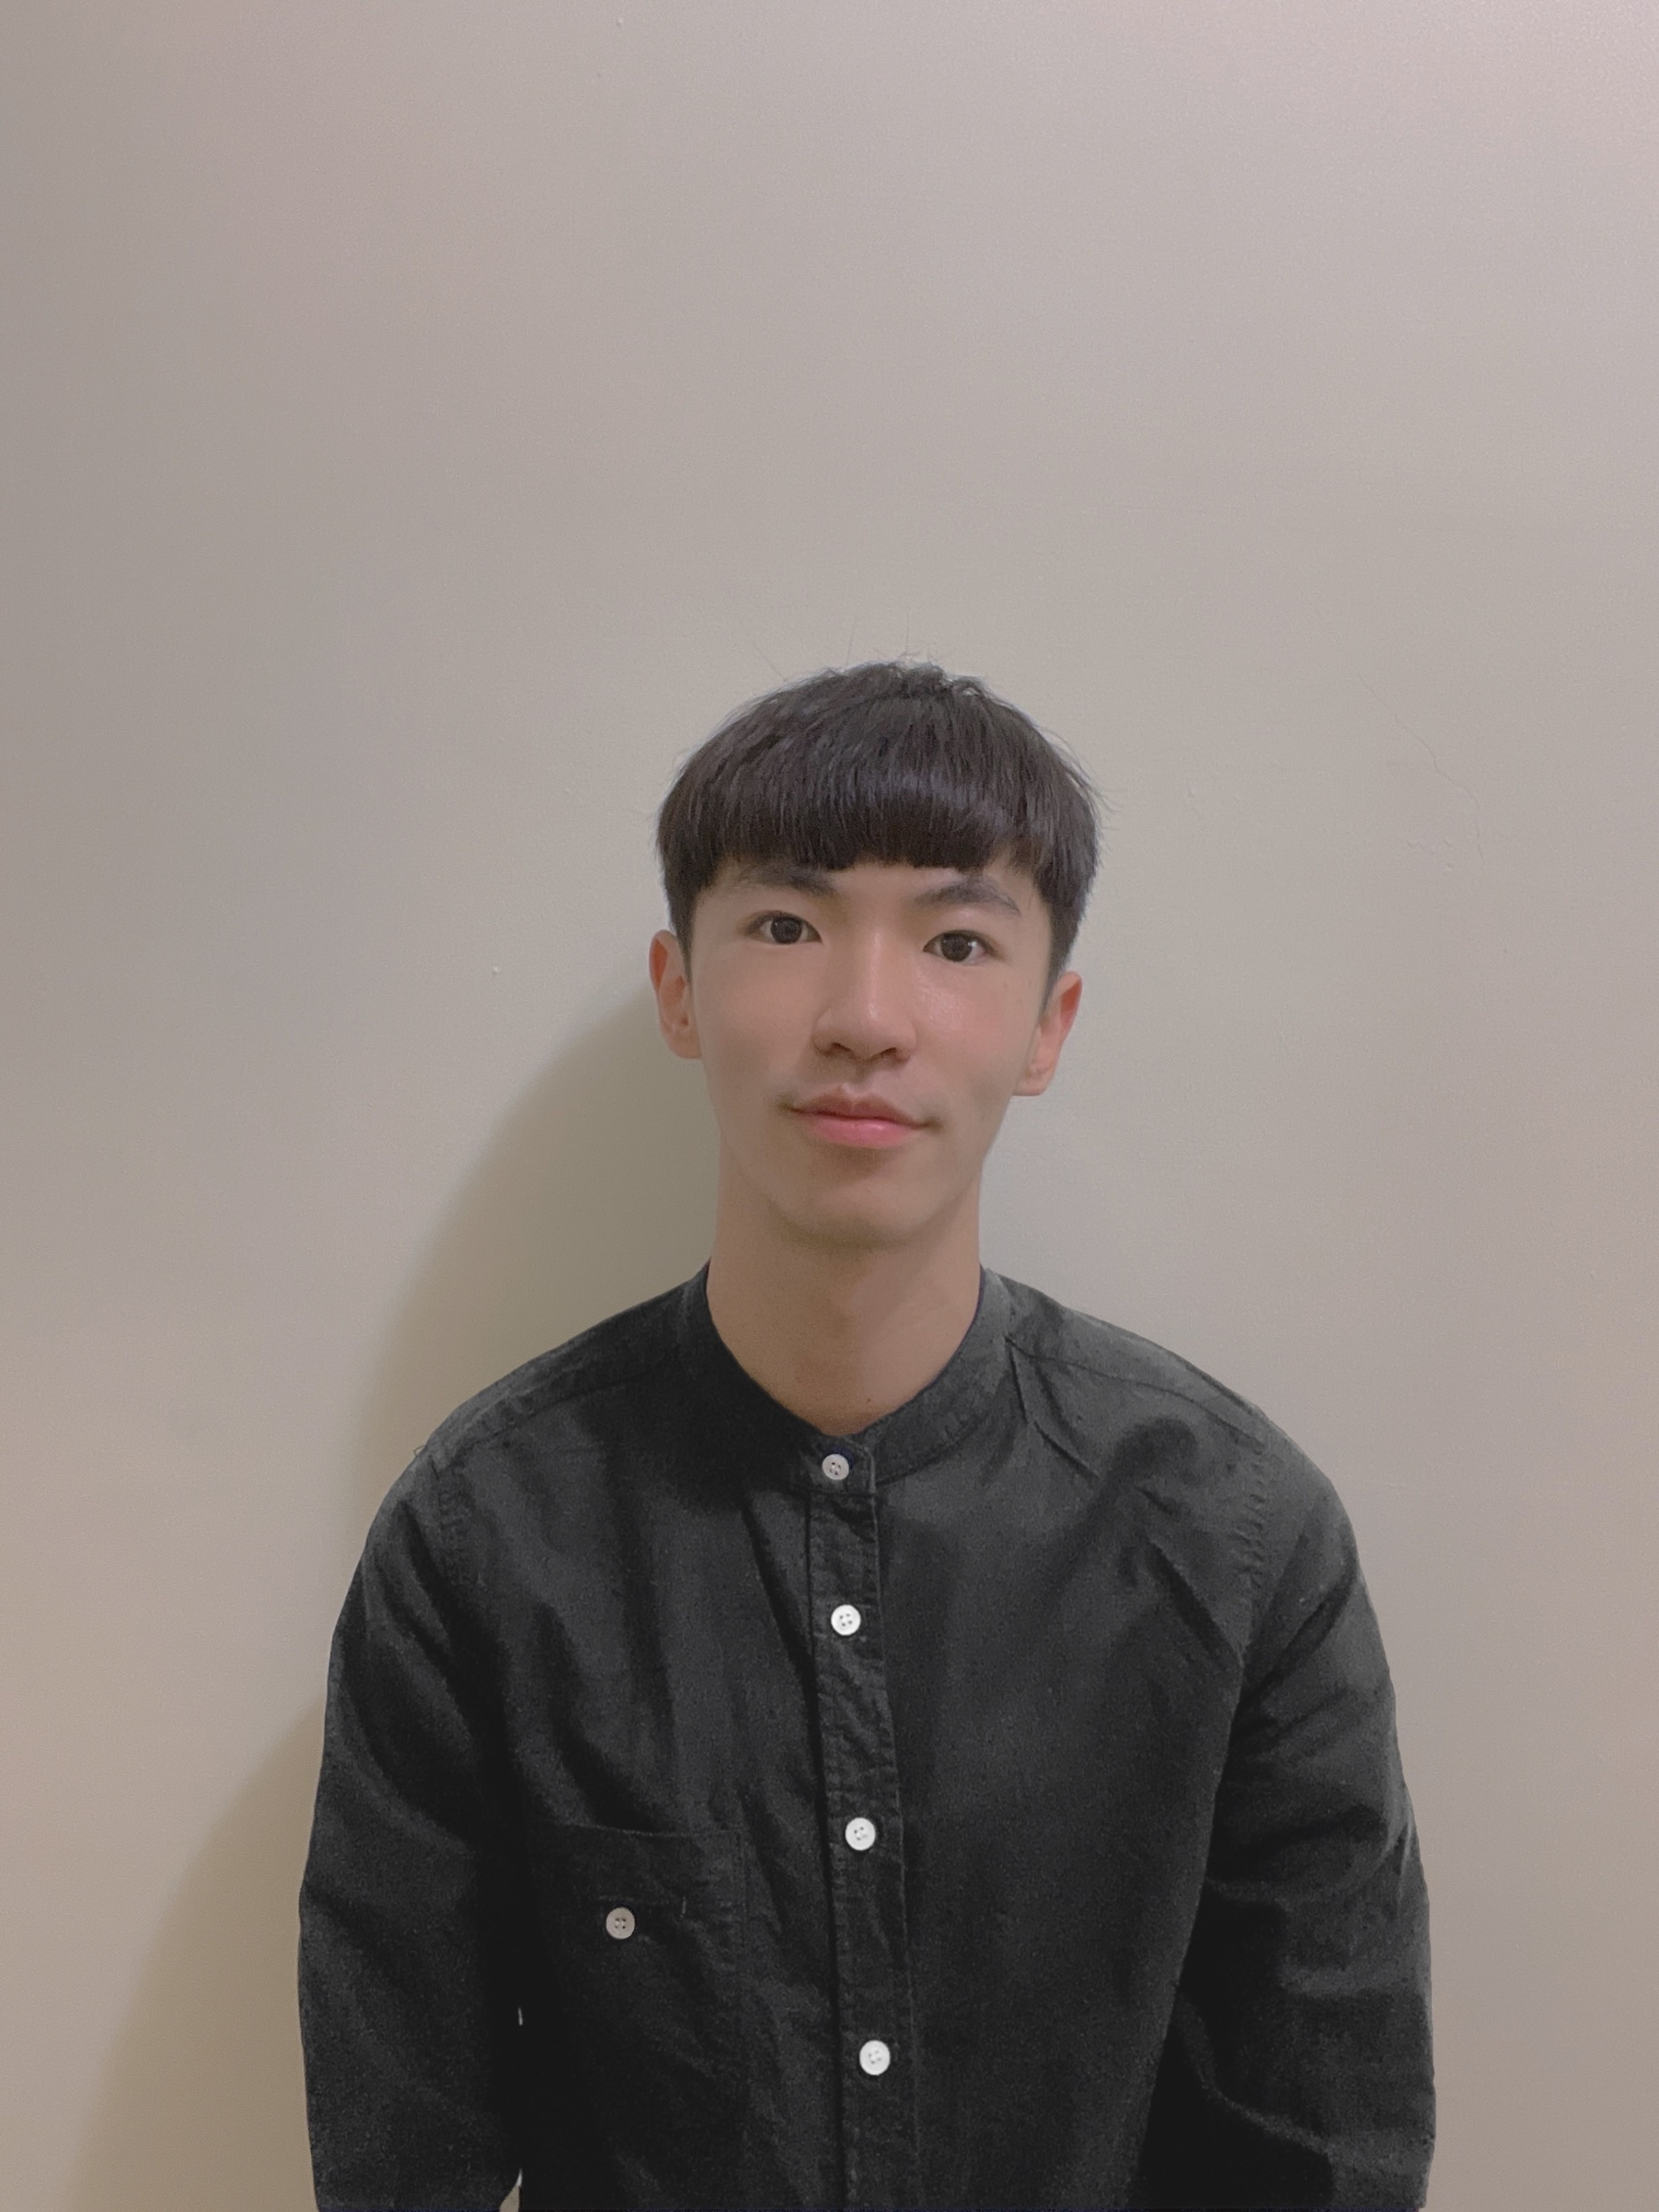

Members
資工系大三
簡志宇
資工系大三
鄭博薪
資工系大三
李彥璋
資工系大三
周昱宏

Slide 3

Motivation
In recent years, streaming services is booming. More and more people like to watch anime on the Internet. Sometimes we saw an anime picture which we don’t know the name of this anime, but we want to get the information. Therefore, we propose this project to solve this problem.

Slide 4
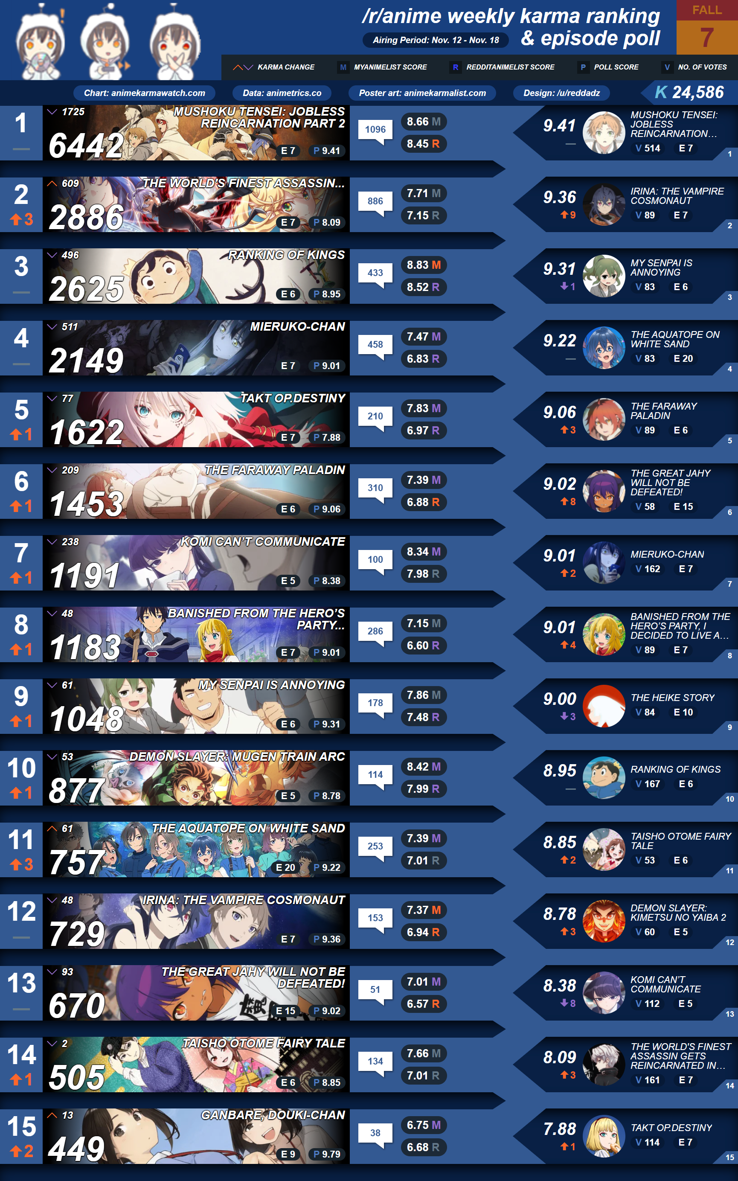
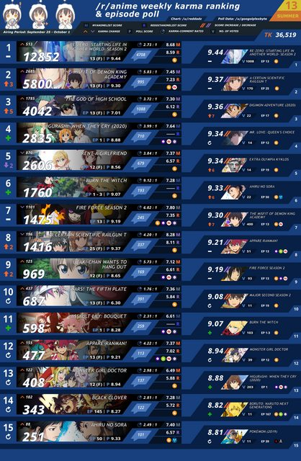
Database
At a specific time
Ex. 2021 Fall, 2020 Summer…

Slide 5



GOAL
Given photos of main characters of an anime
Find out the anime where the characters appear.
List the songs(openings) of the anime.

Slide 6


Expected Achievement

